Slide 1
Spinnaker Introduction
By OpxMx

Slide 2
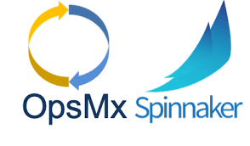
History Spinnaker
Development Started in 2014 by Netflix.
Battle tested by Netflix in production since 2015
Open Sourced in 2015 November
Backed by Netflix, Google, Microsoft,Veritas, Target, Kenzen etc..

Slide 3
What is Spinnaker ?
Spinnaker is Open Source Multi Cloud continuous delivery platform.
Spinnaker also supports Application management.
Build for releasing software changes with high velocity and with confidence in the Production.
Spinnaker is Designed with pluggability in mind.
With Spinnaker we Create and deploy immutable images for faster rollouts, easier rollbacks, and the elimination of hard to debug configuration drift issues.
Spinnaker Support all Major Cloud Providers out there.
Google Cloud, AWS, Azure, Google App Engine, OpenStack, Kubernetes, Oracle Cloud etc..,
Using Spinnaker we can Create deployment pipelines that run Integration and System tests.
Trigger pipelines via git events, Jenkins, Travis CI, Docker, CRON, or other Spinnaker pipelines.

Slide 4
Why Spinnaker ?
The Goal of Spinnaker is to make reliable deployments.
Spinnaker offers deployment pipeline and also allows for easy rollbacks.
Built for High Velocity, (i.e) deploy faster and often.
Spinnaker has Flexible pipeline management system.
Big active and vibrant community
Integration with all the major cloud providers supports both on-prem and kubernetes.
Loaded with Feature-rich settings :-
CI Integration
CLI for setup and Admin
VM Bakery
Role-Based Access Control
Whitelisted Execution Window
Monitoring Integration
Notification & Manual Judgement
Chaos Monkey Integration

Slide 5
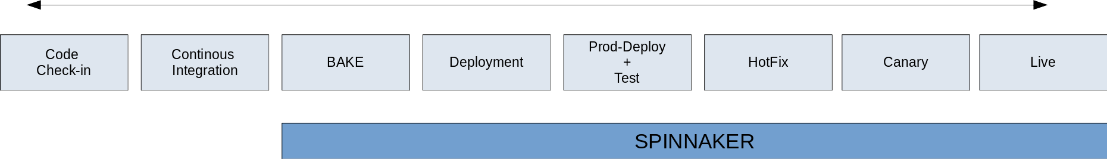
Why Spinnaker
😃
😥

Slide 6
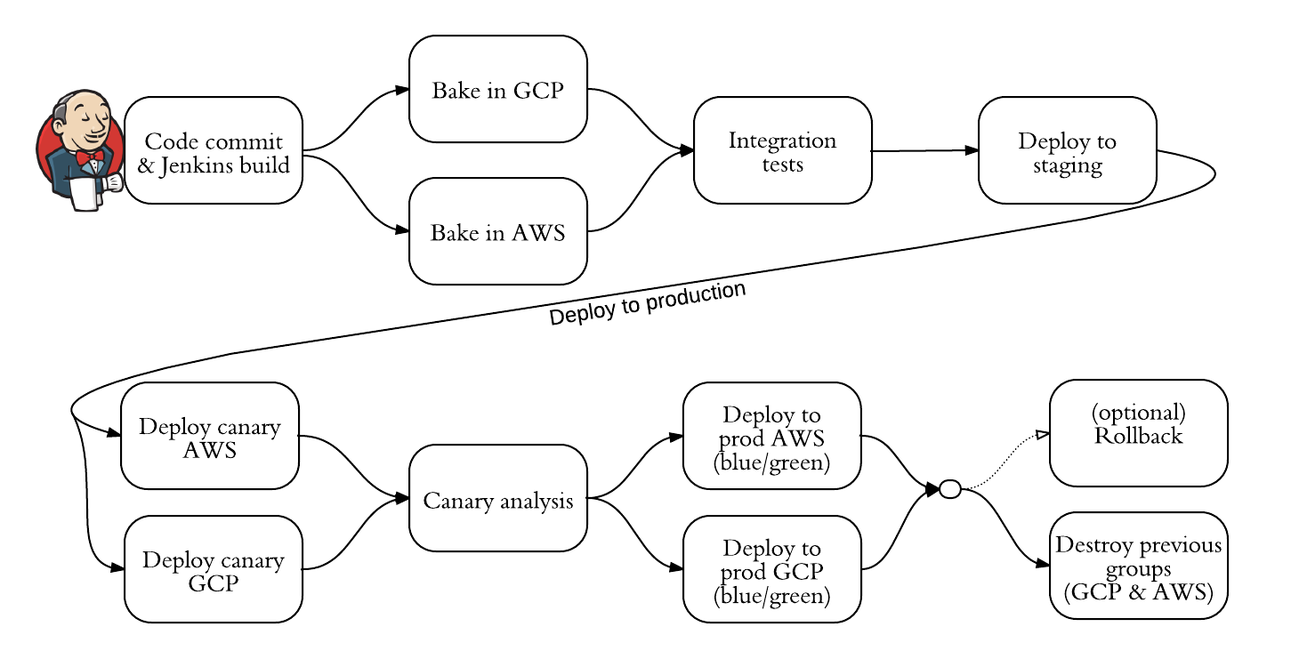
Google Waze - Spinnaker Overview

Slide 7
Thank You :)

